Slide 1
HUMAN RESOURCE MANAGEMENT SYSTEM
SUBMITTED BY
SHILPI BARUA
SOUMILI SAMANTA
DEBARATI BHATTACHARJEE

Slide 2
OBJECTIVES
Administer compensation, benefits and performance management systems, and safety and recreation programs.
Identify staff vacancies and recruit, interview and select applicants.
Provide current and prospective employees with information about policies, job duties, working conditions, wages, opportunities for promotion and employee benefits.
Serve as a link between management and employees by handling questions, interpreting and administering contracts and helping resolve work-related problems.

Slide 3
HARDWARE / SOFTWARE REQUIREMENT SPECIFICATION
Hardware Requirements…
Configuration (minimum): -
Intel® Pentium® 3 1.3 GHz processor with 256 KB Cache
256 MB RAM.
80 GB Hard Disk Drive.
3.5” – 1.44 MB Diskette Drive.
52X CD-ROM Drive.
Intel® Pro 10/100+ LAN Card.
Printer.
Software Requirements for designing this application
Windows 2000 Server or XP, onwards
Microsoft Visual Studio
Oracle

Slide 4
Characteristics Of Back-End
Queries against the shared resources
Management (Application and data)
Transaction and processing
Centralized application logic
Communication and computation

Slide 5
Characteristics Of Front-End
Pallet of visual tools for designing screens allows the programmers to create sophisticated multiple window user interfaces without writing any code.
Graphical elements you create on the screen are displayed just as they will appear to the end user.
The application can be created, designed and run in any web browser.

Slide 6
PROBLEM DEFINITION & REQUIREMENTS SPECIFICATIONS
Problem Definition
Actually the study phase is considered as the requirement analysis, which is the most vital part of the software development life cycle (SDLC).
Analysis is a software engineering task that bridges the gap between system level requirements engineering and system design. This phase consists of…
System Engineering
Software Requirement Analysis
Software Design
The Analysis may be divided into five (5) parts of works, i.e.
Problem Recognition
Evaluation and Synthesis
Modeling
Specification
Review

Slide 7
Requirements Specifications
Getting information about all those queries by himself, the analyst starts working and he issues some questionnaires to the future users for gathering information and then after that concentrates on the feasibility studies.
System Requirement Specification or SRS had been prepared after proper discussion with the persons attached with the mentioned “HR Management System”..
The SRS will remain incomplete if it is not known the details of working process of such type of institution related with such a chat service.
The purpose of the preliminary investigation is to collect information for developing broad solutions for the purpose of feasibility study. Following the four broad methodologies, which are described as follows:
Carries on the preliminary investigation through:-
Interview & Questionnaires.
Document Surveys.
Information gathering by detailed studying the same type of organization and also surfing through net.
After the verbal interview session is over, it was very clear that the team requires undergoing

Slide 8
Feasibility Study
Feasibility study is one of the most important factors to undergo a process of software development, it is considered as one of the first step of SDLC. There remain various kinds of feasibility studies, but most important of them for a software development is : -
Economic Feasibility: It is the most widely used phase of a feasibility study, which is very popularly known as Cost/Benefit Analysis.
Cost-Benefit Analysis:-
Considering the above mentioned facts and also from some collected data and figures, it became evident that though the system will be economically feasible both for developer as well as for client’s respect, and technical feasibility centers on the existing computer system (hardware, software, etc.), up to what level it can support the proposed addition, etc. all are feasible.
Technical Feasibility: It is a study of technical supports, and constrains that may affect the ability to achieve an acceptable system is the next important issue to be sorted out. In our application the system development is found technically feasible.

Slide 9
Behavioral Feasibility: People are inherently resistant to change, and computers have been known to facilitate change. An estimate should be made of how strong a reaction the user staff is likely to have toward the development of a computerized system. It is understandable that the introduction of a computerized system requires special effort to educate, sell, and train the staff on new ways of conducting business.
Legal Feasibility: A determination of any infringement, violation or liability that could result from the development of the system. It is very much required for our mentioned application where authorization is an essential factor.

Slide 10
ENTITIES AND ATTRIBUTES
ENTITIES | ATTRIBUTES
Administrator | adminid, firstname, lastname, username, adminpwd ,addeddate
Department | DepartmentID, DepartmentCode, DepartmentName, CurrentStrength, MaxNoEmp
Designation | DesignationID, DesignationCode, DesignationName

Slide 11
ENTITIES | ATTRIBUTES
Employee | EmployeeID, DepartmentID, DesignationID, EmployeeCode, FirstName, LastName, Gender, DateOfBirth, UserName, Pwd, Address, EmailID, PhoneNo, Nationality
Client | ClientID, ClientCode, ClientName, EmailID,Country, AddedDate
Project | ProjectID, ProjectCode, ProjectName, ClientID, StartDate, EndDate, AddedDate, Status

Slide 12
ENTITIES | ATTRIBUTES
Project assigned | AssignmentID, EmployeeID, ProjectID
Daily time sheet | DailyTimeSheetID, EmployeeID, ProjectID, EntryDate, Hours, Minutes
Candidate | CandidateID, CandidateCode, FirstName, LastName, DOB, Gender, Address, PhoneNo, EmailID, Department, Designation, College, Stream, Percentage, Nationality, Skill, Experience
Appointment | AppointmentID, CandidateID, AppointmentNo, IssueDate, Authority, interviewDate, ProbationPeriod, JoiningDate, Salary

Slide 13
ENTITIES | ATTRIBUTES
Postinterview | PostinterviewID, CandidateID, interviewLevel, PostAppFor, OfferedSalary, Selectionstatus, interviewerCode, interviewerName, interviewerDesignation

Slide 14
Relationships:
Administrator controls Departments
Administrator controls Employee
Administrator deals with Clients
Administrator selects Candidate
Employee has Designation
Employee works on Department
Employee assigned Project
Client deals with Project
Project deals with Project assigned
Project deals with Daily time sheet
Candidate face interview in Post interview
In Post interview if a candidate selected then Appointment

Slide 15
ENTITY – RELATIONSHIP DIAGRAM

Slide 16
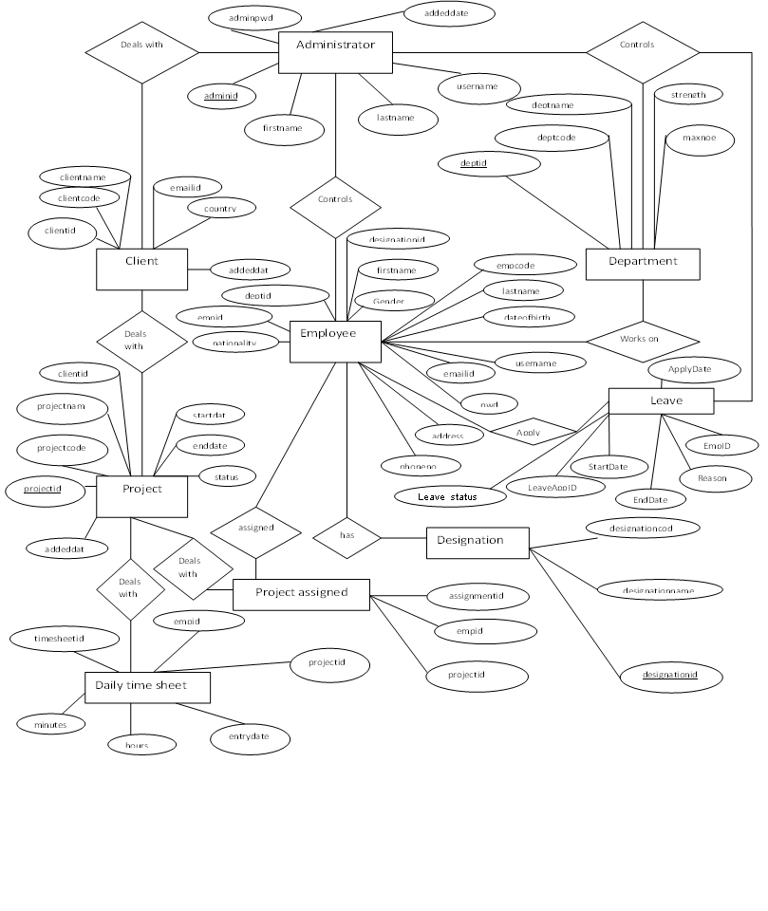

Slide 17
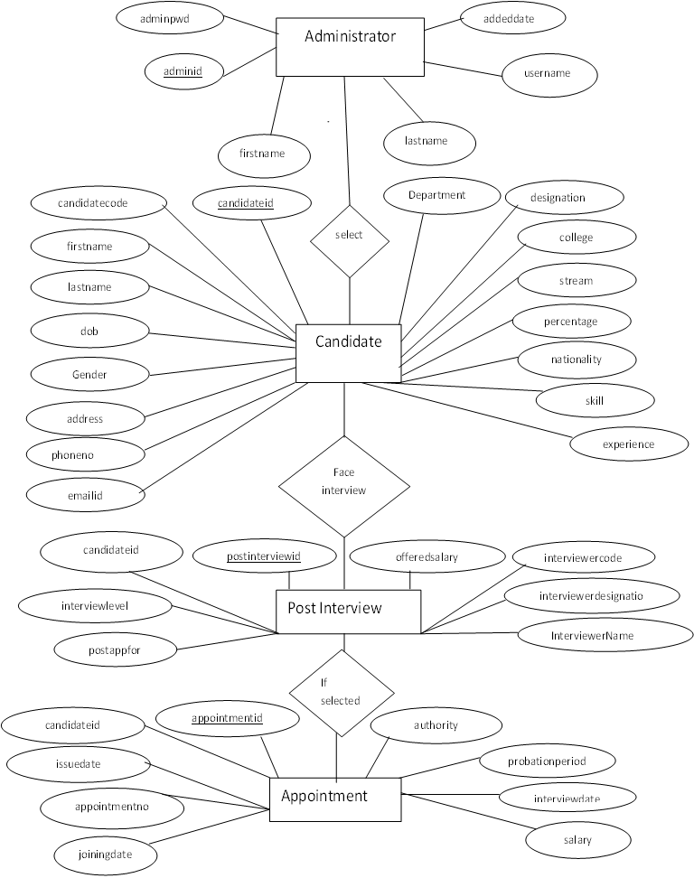

Slide 18
DATA DICTIONARY
A data dictionary is a catalogue – a repository – of the elements in a system. As the name suggests, these elements center around data the way they are structured to meet user requirements and organization needs. In a data dictionary you will find a list of all the elements composing the data flow through a system.

Slide 19
TABLE : Administrator
NAME | TYPE | NULL | KEY
adminid | number(10) | Not Null | Primary Key
firstname | varchar2(30)
lastname | varchar2(30)
username | varchar2(30)
adminpwd | varchar2(30)
addeddate | date

Slide 20
TABLE : HRMStblAppointment
NAME | TYPE | NULL | KEY
AppointmentID | number(10) | Not Null | Prymary Key
CandidateID | number(10)
AppointmentNo | varchar2(30)
IssueDate | date
Authority | varchar2(30)
interviewDate | date
ProbationPeriod | number(10)
JoiningDate | date
Salary | number(10)

Slide 21
TABLE: HRMStblAssignment
Name | Type | Null | Key
AssignmentID | number(10) | Not Null | Primary Key
EmpID | number(10)
ProjectID | number(10)

Slide 22
TABLE:HRMStblCandidate
Name | Type | Null | Key
CandidateID | number(10) | Not Null | Primary Key
CandidateCode | varchar2(30)
FirstName | varchar2(30)
LastName | varchar2(30)
DOB | date
Gender | varchar2(30)
Address | varchar2(30)
PhoneNo | varchar2(30)
EmailID | varchar2(30)

Slide 23
Department | number(10)
Designation | number(10)
College | varchar2(30)
Stream | varchar2(30)
Percentage | varchar2(30)
 | varchar2(30)
 | varchar2(30)
 | varchar2(30)

Slide 24
TABLE :HRMStblClient
Name | Type | Null | Key
ClientID | number(10) | Not Null | Primary Key
ClientCode | number(10)
ClientName | varchar2(30)
EmailID | varchar2(30)
Country | varchar2(30)
AddedDate | date

Slide 25
TABLE : HRMStblDailyTimeSheet
Name | Type | Null | Key
DailyTimeSheetID | number(10) | Not Null | Primary Key
EmpID | number(10)
ProjectID | number(10)
EntryDate | date
Hours | number(10)
Minutes | number(10)

Slide 26
TABLE : HRMStblDepartment
Name | Type | Null | Key
DeptID | number(10) | Not Null | Primary Key
DeptCode | varchar2(30)
DeptName | varchar2(30)
CurrentStrength | number(10)
MaxNoEmp | number(10)

Slide 27
TABLE: HRMStblDesignation
Name | Type & Size | Null | Key
DesignationID | number(10) | Not Null | Primary Key
DesignationCode | varchar2(30)
DesignationName | varchar2(30)

Slide 28
TABLE: HRMStblEmployee
Name | Type & Size | Null | Key
EmpID | number(10) | Not Null | Primary Key
DeptID | number(10)
DesignationID | number(10)
EmpCode | varchar2(30)
FirstName | varchar2(30)
LastName | varchar2(30)
Gender | varchar2(30)
DateOfBirth | date
UserName | varchar2(30)
Pwd | varchar2(30)

Slide 29
Name | Type & Size | Null | Key
Address | varchar2(30)
EmailID | varchar2(30)
PhoneNo | varchar2(30)
Nationality | varchar2(30)

Slide 30
TABLE: HRMStblProject
Name | Type & Size | Null | Key
ProjectID | number(10) | Not Null | Primary Key
ProjectCode | varchar2(30)
ProjectName | varchar2(30)
ClientID | number(10)
StartDate | date
EndDate | date
AddedDate | date
Status | varchar2(30)

Slide 31
TABLE: HRMStblLeave
Name | Type & Size | Null | Key
LeaveID | number(10) | Not Null | Primary Key
LeaveAppID | number(10) | Not Null | Primary Key
StartDate | date
EndDate | date
Reason | varchar2(50)
EmpID | number(10)
Leavestatus | varchar2(5)
ApplyDate | date

Slide 32
TABLE: HRMStblPostinterview
Name | Type & Size | Null | Key
PostinterviewID | number(10) | Not Null | Primary Key
CandidateID | number(10)
interviewLevel | varchar2(30)
PostAppFor | varchar2(30)
OfferedSalary | varchar2(30)
SelectionStatus | varchar2(30)
interviewerCode | varchar2(30)
interviewerName | varchar2(30)
interviewerDesignation | varchar2(30)

Slide 33
Normalization:
Normalization is the process of refining the data model built by the ER diagram. The normalization technique, logically groups the data over the number of tables, with minimum redundancy of data. The entities or tables resulting from normalization contain data items, with relationships being represented by replication of key data items.
The goal of relational database design is to generate a set of relation schemes that allow us to store information with minimum redundancy of data and allow us to retrieve information easily and efficiently. The approach followed is to design schemas that are in an appropriate form one of the so-called normal form.
The first step towards normalization is to convert the ER model number(10)o tables or relations. The next step is to examine the database for redundancy and if necessary, change them to non-redundant forms. This non-redundant model is then converted number(10)o a database definition, which achieves the objective of the database design phase . We defined database from the above ER model by normalizing it to 3rd normal form. We will show the definitions of those database tables later at the time of physical database design phase.

Slide 34
Data Flow Diagrams
A graphic tool used to describe and analyze the moment of data through a system – manual or automated – including the processes, stores of data, and delays in the system. Data flow diagrams are the central tools and the basis from which other components are developed. The transformation of data from input to output, through processes, may be described logically and independently of the physical components associated with the system.

Slide 35
Context Level DFD:
Report Data
Report Data
ADMINISTRATOR
0.0
HRMS
EMPLOYEE
Request Data
Request Data

Slide 36
Level 0 DFD
Data Store
0.1
ADMIN
PROCESS
0.2
EMPLOYEE
PROCESS
Request Data
Receive Data
Receive Data
Request Data
ADMINISTRATOR
EMPLOYEE

Slide 37
LEVEL 1 DFD FOR ADMIN PROCESS

Slide 38
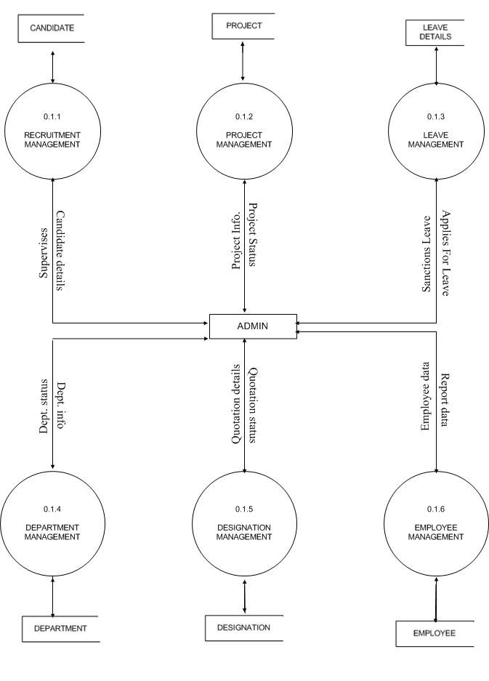

Slide 39
LEVEL 1 DFD FOR EMPLOYEE PROCESS

Slide 40
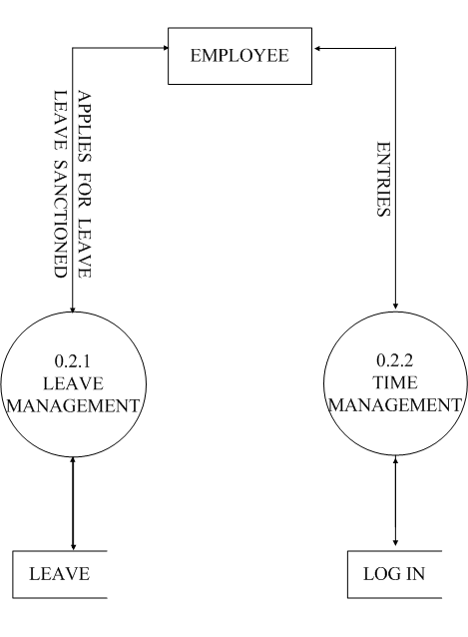

Slide 41
MODULES
Well-structured designs improve the maintainability of a system. A structured system is one that is developed from the top down and modular, that is, broken down number of manageable components. In this project we modularized the system so that they have minimal effect on each other.
Administrative Module deals with department ,employee, client and almost all the purposes related of that company such as leave management ,payroll management and even to manage the project. It is the main part of this software.

Slide 42
Profile Management deals with creation of profiles for new employees along with updating existing profiles. An employee can be searched on the basis of their id and names.
Employee Recruitment deals with registration of new applicants, short listing of applicants for technical rounds then to HR rounds and at last it produces the final list of selected candidates.
Leave Management deals with allocation of leaves to employees, considering various factors Leave apply and Leave approval.
Time Management deals with daily attendance of employees in the organization with enter and update attendance .

Slide 43
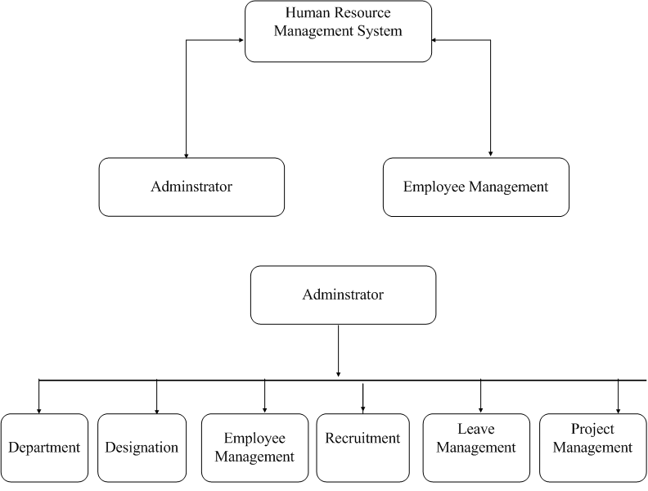

Slide 44
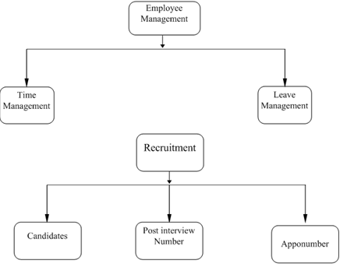

Slide 45
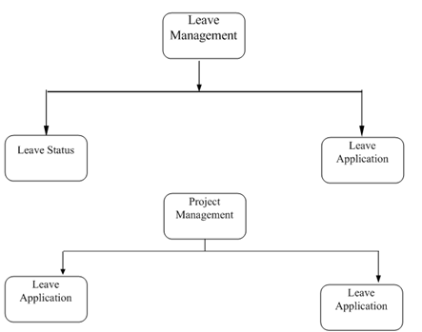

Slide 46
Use–Case Diagram
Use – case diagram shows us the way how we’ll interact with the software as a normal user. The diagram for this software is given below.

Slide 47
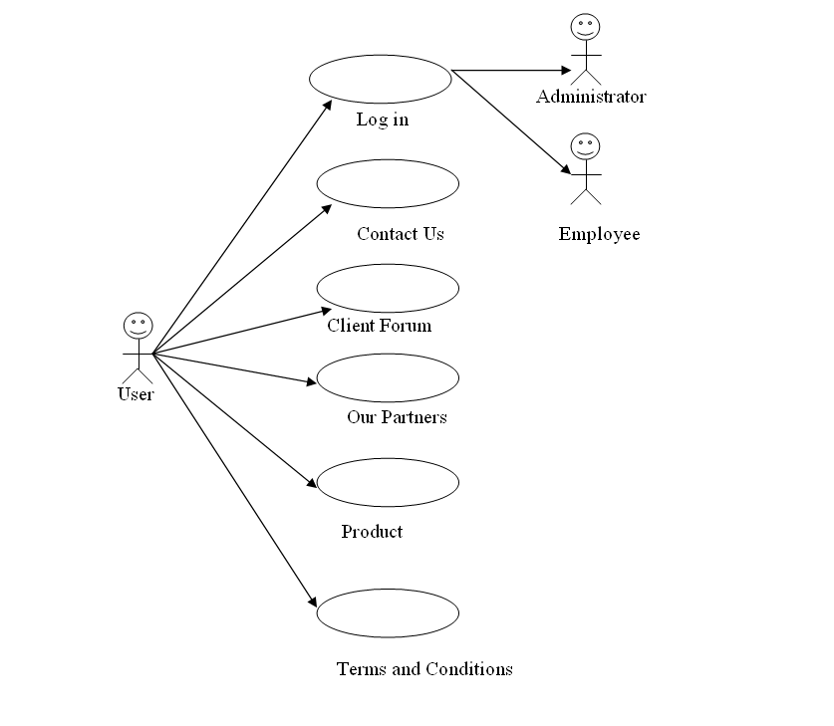

Slide 48
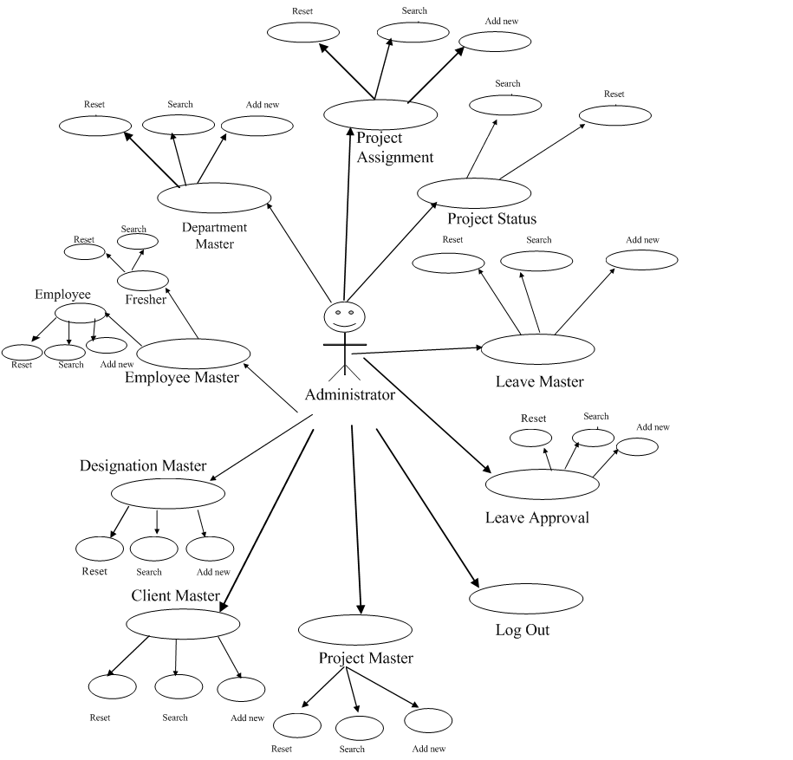

Slide 49
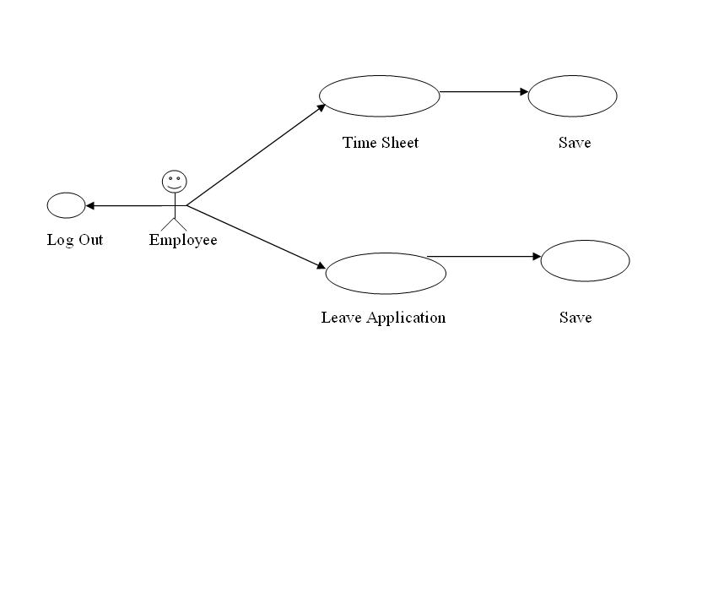

Slide 50
Testing
Introduction
Software Testing is the process of executing a program or system with the intent of finding errors. Or, it involves any activity aimed at evaluating an attribute or capability of a program or system and determining that it meets its required results Software is not unlike other physical processes where inputs are received and outputs are produced. Where software differs is in the manner in which it fails. Detecting all of the different failure modes for software is generally infeasible unlike most physical systems; most of the defects in software are design errors, not manufacturing defects. Software bugs will almost always exist in any software module with moderate size: not because programmers are careless or irresponsible, but because the complexity of software is generally interactable -- and humans have only limited ability to manage complexity.

Slide 51
It is also true that for any complex systems, design defects can never be completely ruled out. Discovering the design defects in software is equally difficult, for the same reason of complexity.
The testing activities are done in all phases of the lifecycle in an iterative software development approach. However, the emphasis on testing activities varies in different phases. This procedure explains the focus of testing in inception, elaboration, construction and transition phases. In the inception phase most of requirements capturing is done and the test plan is developed. In elaboration phase most of design is developed, and test cases are developed. Construction phase mainly focuses on development of components and units, and unit testing is the focus in this phase. Transition phase is about
Deploying software in the user community and most of the system testing and acceptance testing is done in this phase.

Slide 52
Purpose
The main purposes of this procedure are:
To carry out comprehensive testing of the system/product and its individual components in order to ensure that the developed system/product conforms to the user requirements/ design.
To verify the proper integration of all components of the software.
To verify that all requirements have been correctly implemented.
To identify and ensure defects are addressed prior to the deployment of the software.

Slide 53
Testing is usually performed for the following purposes:
To improve quality
Quality means the conformance to the specified design requirement. Being correct, the minimum requirement of quality, means performing as required under specified circumstances. Debugging, a narrow view of software testing, is performed heavily to find out design defects by the programmer. The imperfection of human nature makes it almost impossible to make a moderately complex program correct the first time. Finding the problems and get them fixed, is the purpose of debugging in programming phase.
For Verification & Validation (V&V)
Just as topic Verification and Validation indicated, another important purpose of testing is verification and validation (V&V). Testing can serve as metrics. It is heavily used as a tool in the V&V process. Testers can make claims based on interpretations of the testing results, which either the product works under certain situations or it does not work. We can also compare the quality among different products under the same specification, based on results from the same test.

Slide 54
Test Planning
Initial test plan addresses system test planning, and over the elaboration, construction and transition phases this plan is updated to cater other testing requirements of these phases, like, unit & integration testing.
The test Plan must contain the following:
Scope of testing
Methodology to be used for testing
Types of tests to be carried out
Resource & system requirements
A tentative Test Schedule
Identification of various forms to be used to record test cases and test results .

Slide 55
Testing Methods Used For Project
There is a plethora of testing methods and testing techniques, serving multiple purposes in different life cycle phases. Classified by purpose, software testing can be divided into: Correctness testing, performance tests, reliability testing and security testing. Classified by life-cycle phase, software testing can be classified into the following categories: requirements phase testing, design phase testing, program phase testing, evaluating test results, installation phase testing, acceptance testing and maintenance testing. By scope, software testing can be categorized as follows: unit testing, component testing, integration testing, and system are testing.
Correctness testing
Correctness is the minimum requirement of software, the essential purpose of testing. Correctness testing will need some type of oracle, to tell the right behavior from the wrong one. The tester may or may not know the inside details of the software module under test, e.g. control flow, data flow, etc. Therefore, either a white-box point of view or black-box point of view can be taken in testing software. We must note that the black box and white-box ideas are not limited in correctness testing only.

Slide 56
Black-box testing
The black-box approach is a testing method in which test data are derived from the specified functional requirements without regard to the final program structure It is also termed data-driven, input/output driven or requirements-based testing. Because only the functionality of the software module is of concern, black box testing also mainly refers to functional testing -- a testing method emphasized on executing the functions and examination of their input and output data. The tester treats the software under test as a black box -- only the inputs, outputs and specification are visible and the functionality are determined by observing the outputs to corresponding Inputs. In testing, various inputs are exercised and the outputs are compared against specification to validate the correctness. All test cases are derived from the specification. No implementation details of the code are considered.
The research in black box testing mainly focuses on how to maximize the effectiveness of testing with minimum cost, usually the number of test cases. Partitioning is one of the common techniques. If we have partitioned the input space and assume all the input values in a partition is equivalent, then we only need to test one representative value in each partition to sufficiently cover the Whole input space. Domain testing partitions the input domain into regions, and considers the input values in each domain an equivalent class. Domains can be exhaustively tested and covered by selecting a representative value(s) in each domain. Boundary values are of special interest.

Slide 57
White-box testing
Contrary to black box testing, software is viewed as a white-box, or glass-box in white-box testing, as the structure and flow of the software under test are visible to the tester. Testing plans are made according to the details of the software implementation, such as programming language, logic, and styles. Test cases are derived from the program structure. White-box testing is also called glass-box testing, logic-driven testing or design-based testing. There are many techniques available in white-box testing, because the problem of interactability is eased by specific knowledge and attention on the structure of the software under test. Control-flow testing, loop testing, and data-flow testing, all maps the corresponding flow structure of the software into a directed graph. Test cases are carefully selected based on the criterion that all the nodes or paths are covered or traversed at least once.
We may be reluctant to consider random testing as a testing technique. The test case selection is simple and straightforward: they are randomly chosen. Study in indicates that random testing is more cost effective for many programs. Some very subtle errors can be discovered with low cost. One can also obtain reliability estimate using random testing results based on operational profiles. Effectively combining random testing with other testing techniques may yield more powerful and cost-effective testing strategies.

Slide 58
Performance testing
Not all software systems have specifications on performance explicitly. But every system will have implicit performance requirements. The software should not take infinite time or infinite resource to execute. "Performance bugs" sometimes are used to refer to those design problems in software that cause the system performance to degrade.
Performance evaluation of a software system usually includes: resource usage, throughput, and stimulus-response time and queue lengths detailing the average or maximum number of tasks waiting to be serviced by selected resources. Typical resources that need to be considered include network bandwidth requirements, CPU cycles, disk space, disk access operations, and memory usage. The goal of performance testing can be Performance bottleneck identification, performance comparison and evaluation, etc. The typical method of doing performance testing is using a benchmark -- a program, workload or trace designed to be representative of the typical system usage.

Slide 59
Reliability testing
Software reliability refers to the probability of failure-free operation of a system. It is related to many aspects of software, including the testing process. Directly estimating software reliability by quantifying its related factors can be difficult. Testing is an effective sampling method to measure software reliability. Therefore, based on the estimation, the developers can decide whether to release the software, and the users can decide whether to adopt and use the software. Risk of using software can also be assessed based on reliability information. Advocates that the primary goal of testing should be to measure the dependability of tested software. There is agreement on the intuitive meaning of dependable software: it does not fail in unexpected or catastrophic ways. Robustness testing and stress testing are variances of reliability testing based on this simple criterion.
Security testing
Software quality, reliability and security are tightly coupled. intruders to open security holes can exploit flaws in software. With the development of the internet, software security problems are becoming even more severe. Many critical software applications and services have integrated security measures against malicious attacks.

Slide 60
Maintenance
Definition
Maintenance is very important task & is poorly managed. Times spent and effort required in maintaining software and keeping it operational takes about 40 % to 70% of the total cost of the life cycle.
“Software maintenance is the activity that includes error corrections, enhancements of capabilities, deletion of obsolete capabilities and optimization.” Basically, any work done to change the software after it is in operation is considered to be maintenance. Its purpose is to preserve the value of the software.

Slide 61
Categories
Corrective Maintenance
It means modifications made to the software to correct the defects. Defects can result from design errors, logic errors, coding errors, data processing errors and system performance errors.
Adaptive Maintenance
It includes modifying the software to match changes in the ever-changing environment. Environment refers to the totality of all conditions and influences which act from outside upon the software. E.g. business rules, government policies, work patterns and software/hardware operating platforms.
Perfective Maintenance
It means improving processing efficiency or performances, or restructuring the Software to improve changeability.

Slide 62
Process
The process of maintenance for given software can be divided into four stages as follows:
Program understanding: It consists of analyzing the program in order to understand it. The ease of understanding the program is primarily affected by complexity and documentation of the program.
Generate particular maintenance proposal: The ease of generating the maintenance proposal is primarily affected by extensibility of the program.
Account for ripple effect: If any change is made to any part of the system, it may affect the other parts also. Thus, there is a kind of ripple effect from the location of modification to the other parts of the software. The primary feature affecting the ripple effect is stability.
Modified program testing: The modified program is to be tested again and again to check that the software has enhanced and reliability is validated.

Slide 63
Models
The models that present for the maintenance of the Software are –
Quick-Fix Model
Iterative Enhancement Model
Reuse Oriented Model
Boehm’s Model

Slide 64
SCOPE
Establishing and Maintaining Interpersonal Relationships — developing constructive and cooperative working relationships with others, and maintaining them over time.
Communicating with Supervisors, Peers, or Subordinates — providing information to supervisors, co-workers, and subordinates by telephone, in written form, e-mail, or in person.
Conduct or attend staff meetings
Consult with managerial or supervisory personnel
Making Decisions and Solving Problems — Analyzing information and evaluating results to choose the best solution and solve problems.
Determine project methods and procedures
Staffing Organizational Units — Recruiting, interviewing, selecting, hiring, and promoting employees in an organization.
Developing and Building Teams — Encouraging and building mutual trust, respect, and cooperation among team members.

Slide 65
Maintain job descriptions
Recommend personnel actions, such as promotions, transfers, and dismissals.
Coaching and Developing Others — Identifying the developmental needs of others and coaching, mentoring, or otherwise helping others to improve their knowledge or skills.
Training and Teaching Others — Identifying the educational needs of others, developing formal educational or training programs or classes, and teaching or instructing others.
Provide Consultation and Advice to Others — Providing guidance and expert advice to management or other groups on technical, systems-, or process-related topics.
Documenting/Recording Information — Entering, transcribing, recording, storing, or maintaining information in written or electronic/magnetic form.
Updating and Using Relevant Knowledge — Keeping up-to-date technically and applying new knowledge to your job.
compile numerical or statistical data

